Slide 1
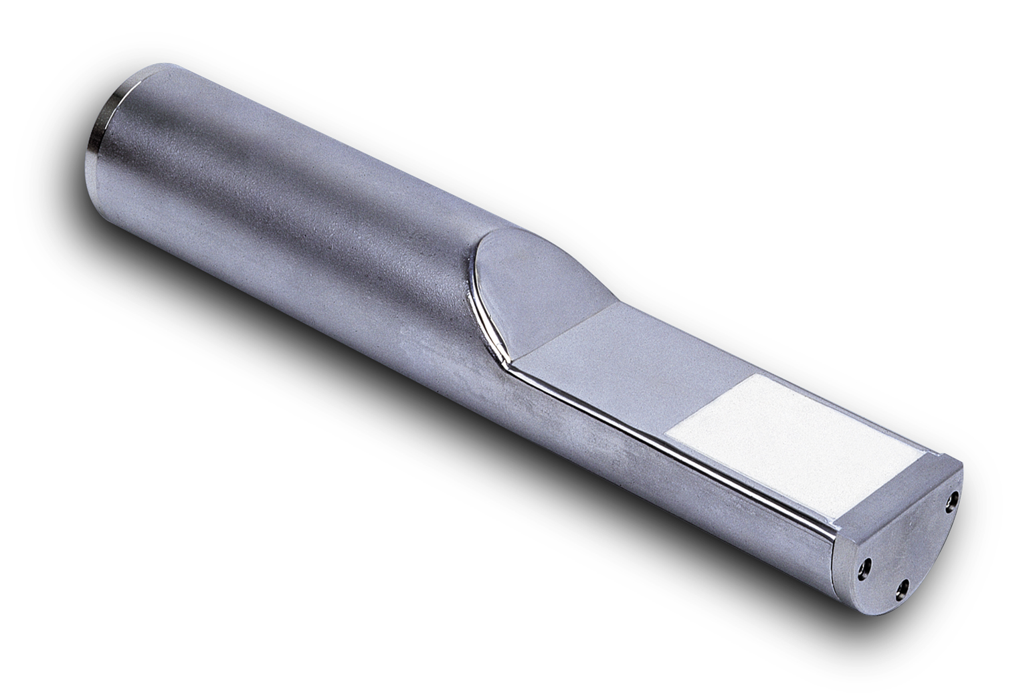
Microwave Moisture Measurement
Aggregate measurement
Hydro-Probe II, Modell HP02

Slide 2
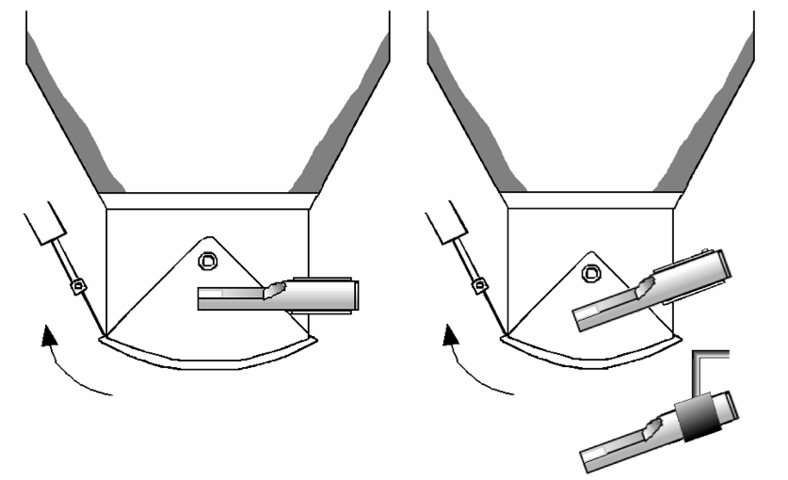
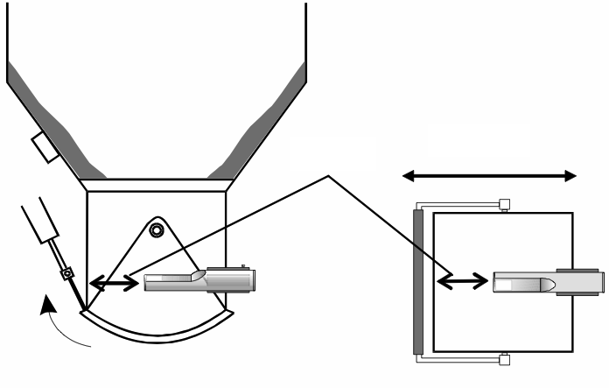
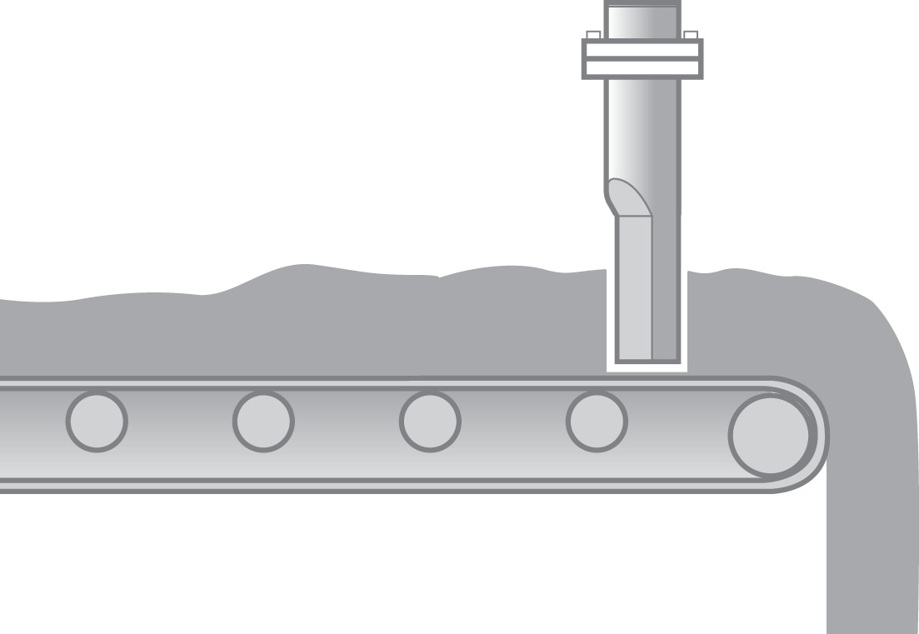
Microwave Moisture Measurement
Aggregate measurement
Installation in bins and silos
Installation on conveyor belts

Slide 3
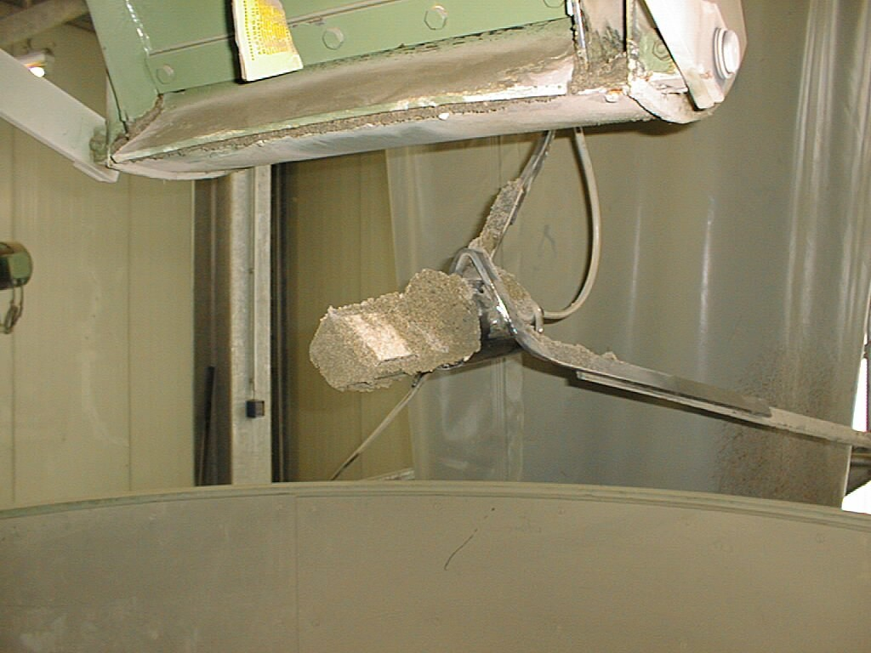
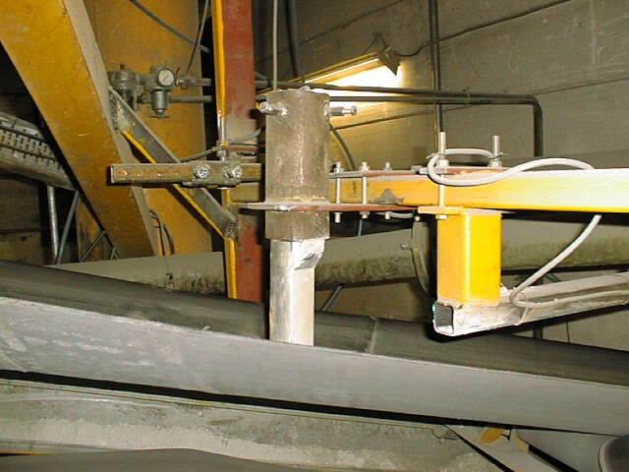
Microwave Moisture Measurement
Aggregate measurement

Slide 4
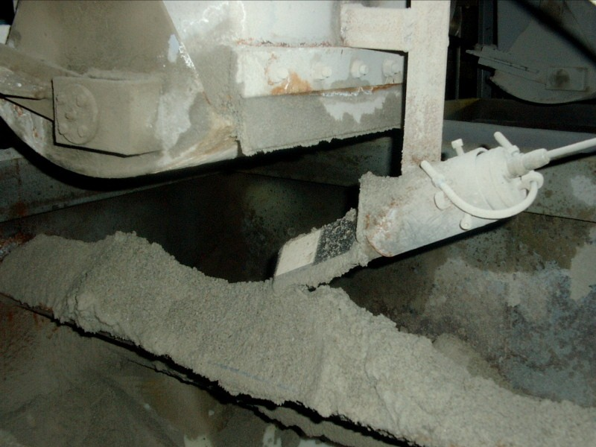
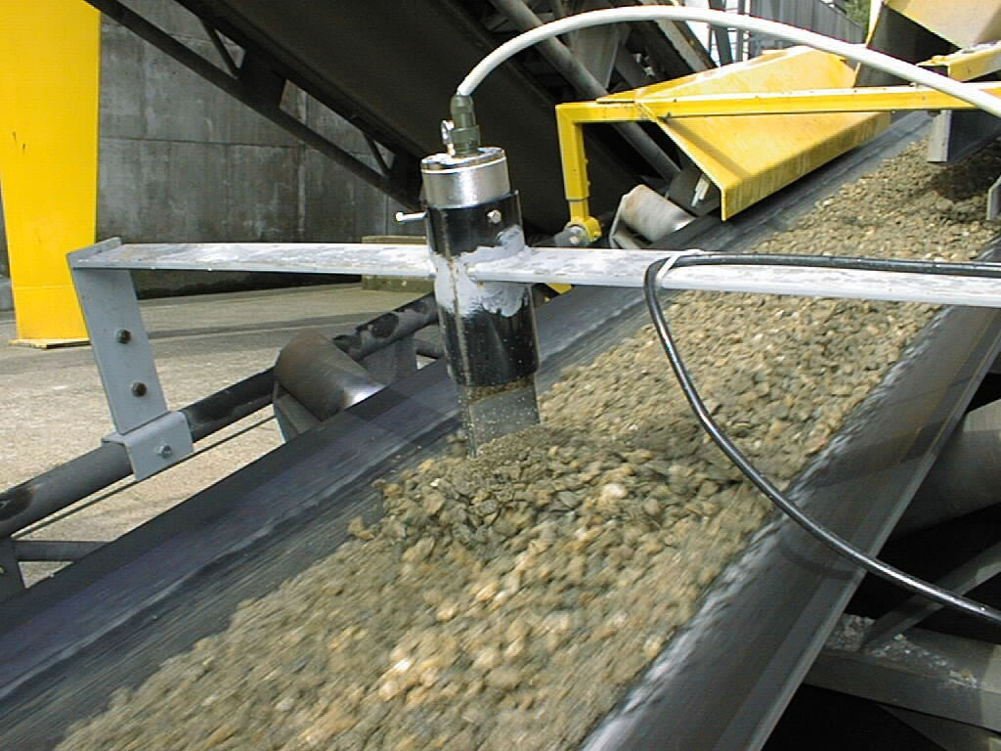
Microwave Moisture Measurement
Aggregate measurement

Slide 5
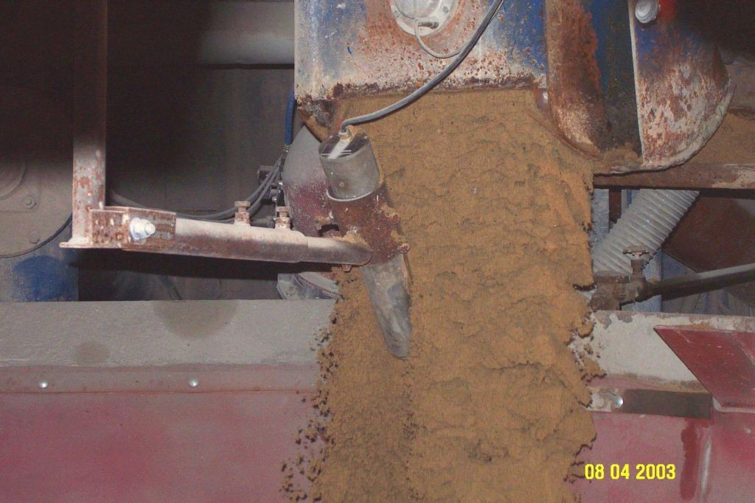
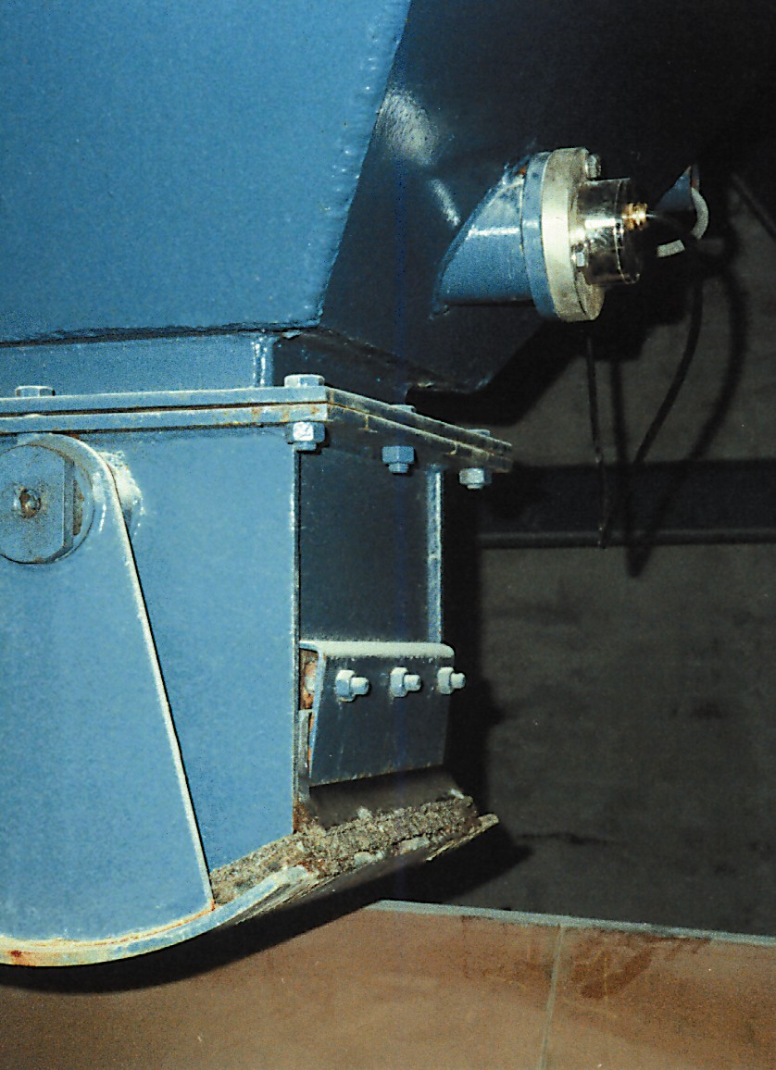
Microwave Moisture Measurement
Aggregate measurement

Slide 6
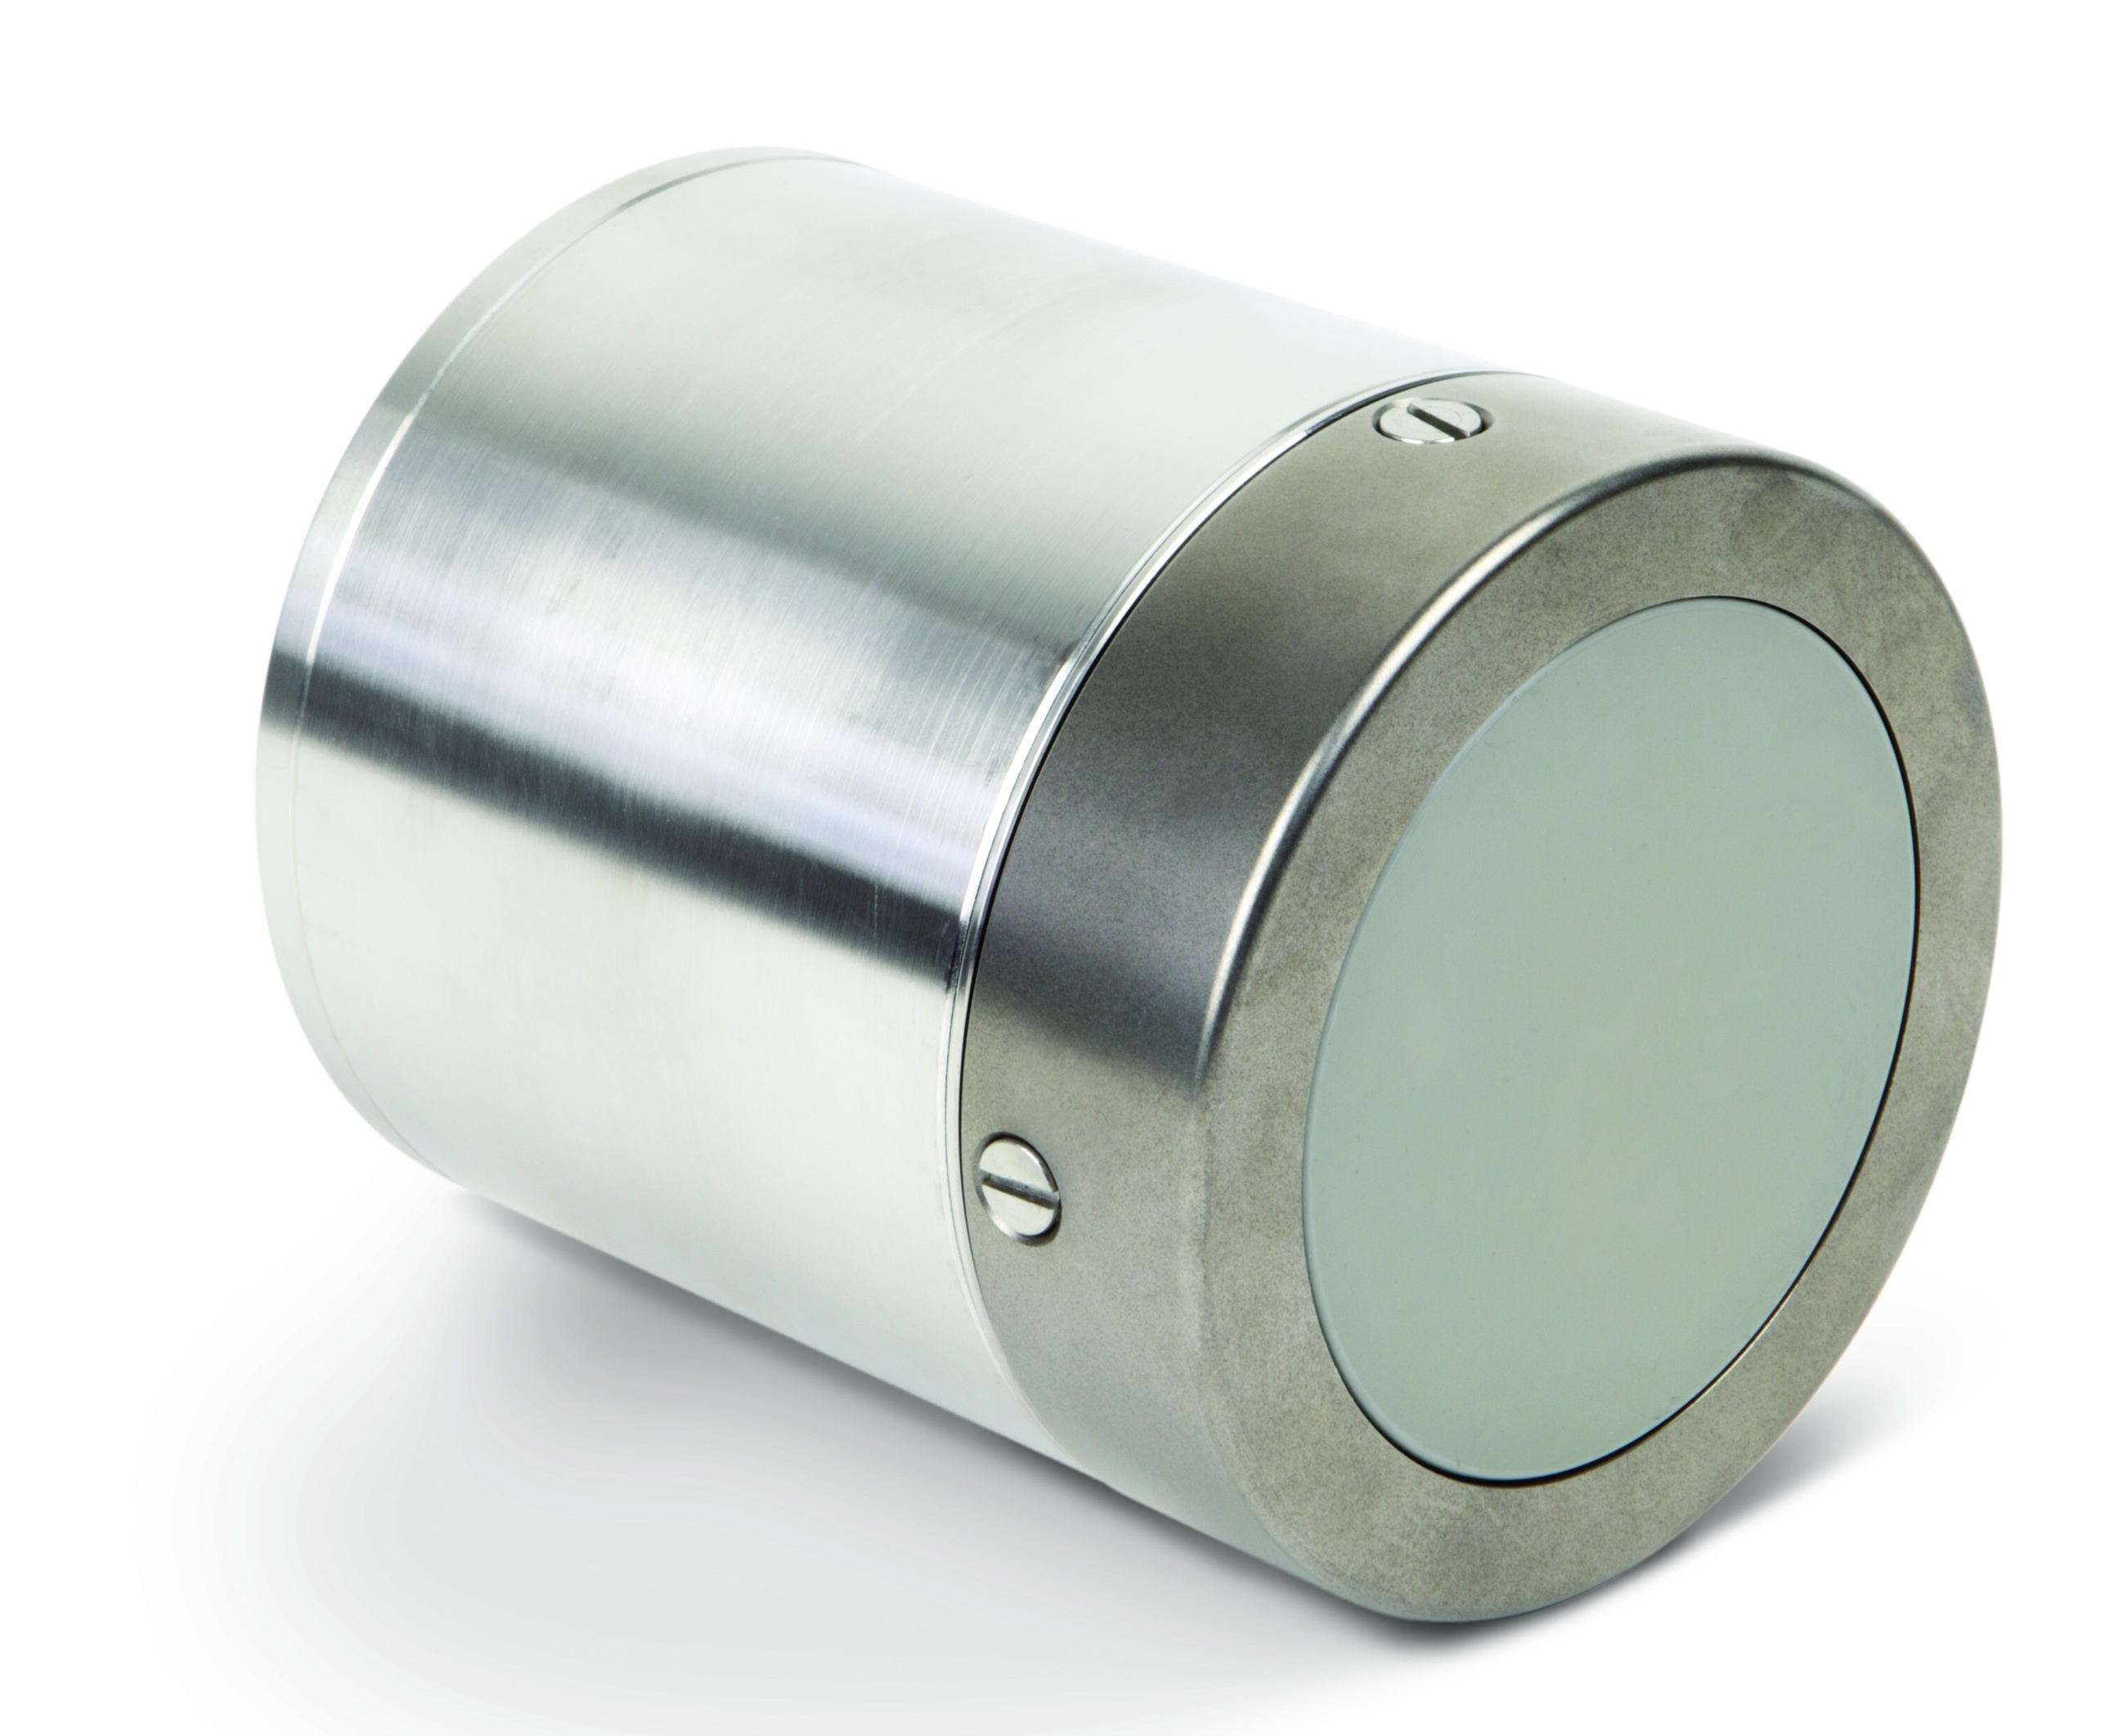
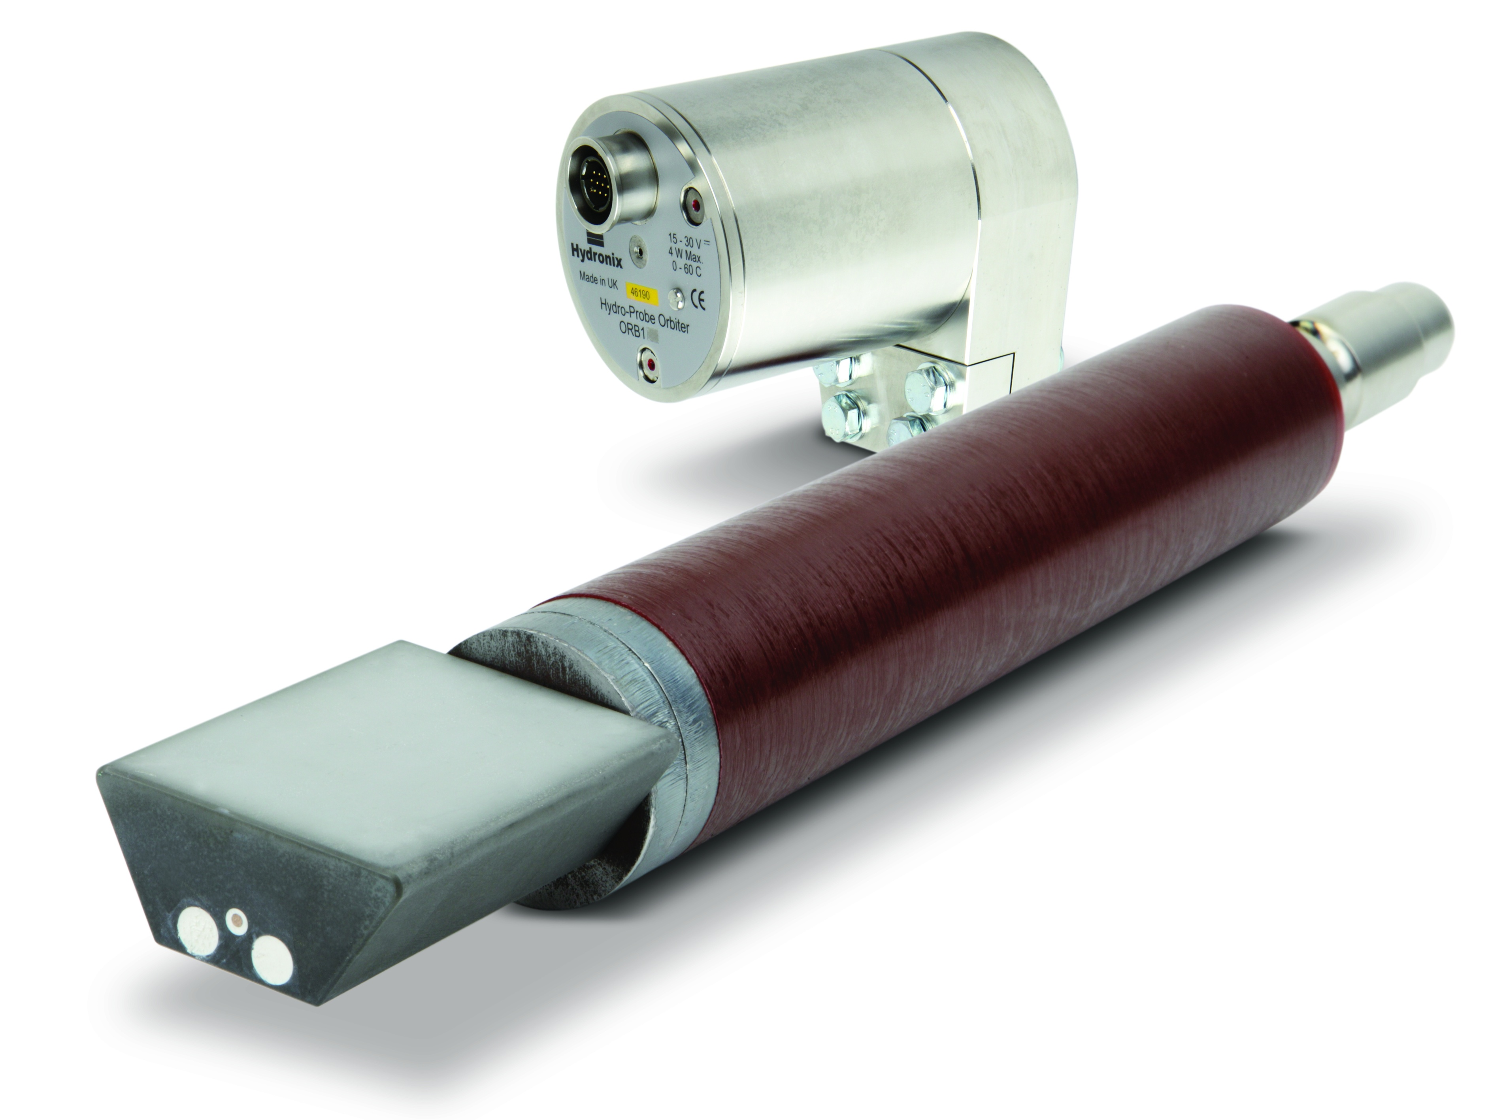
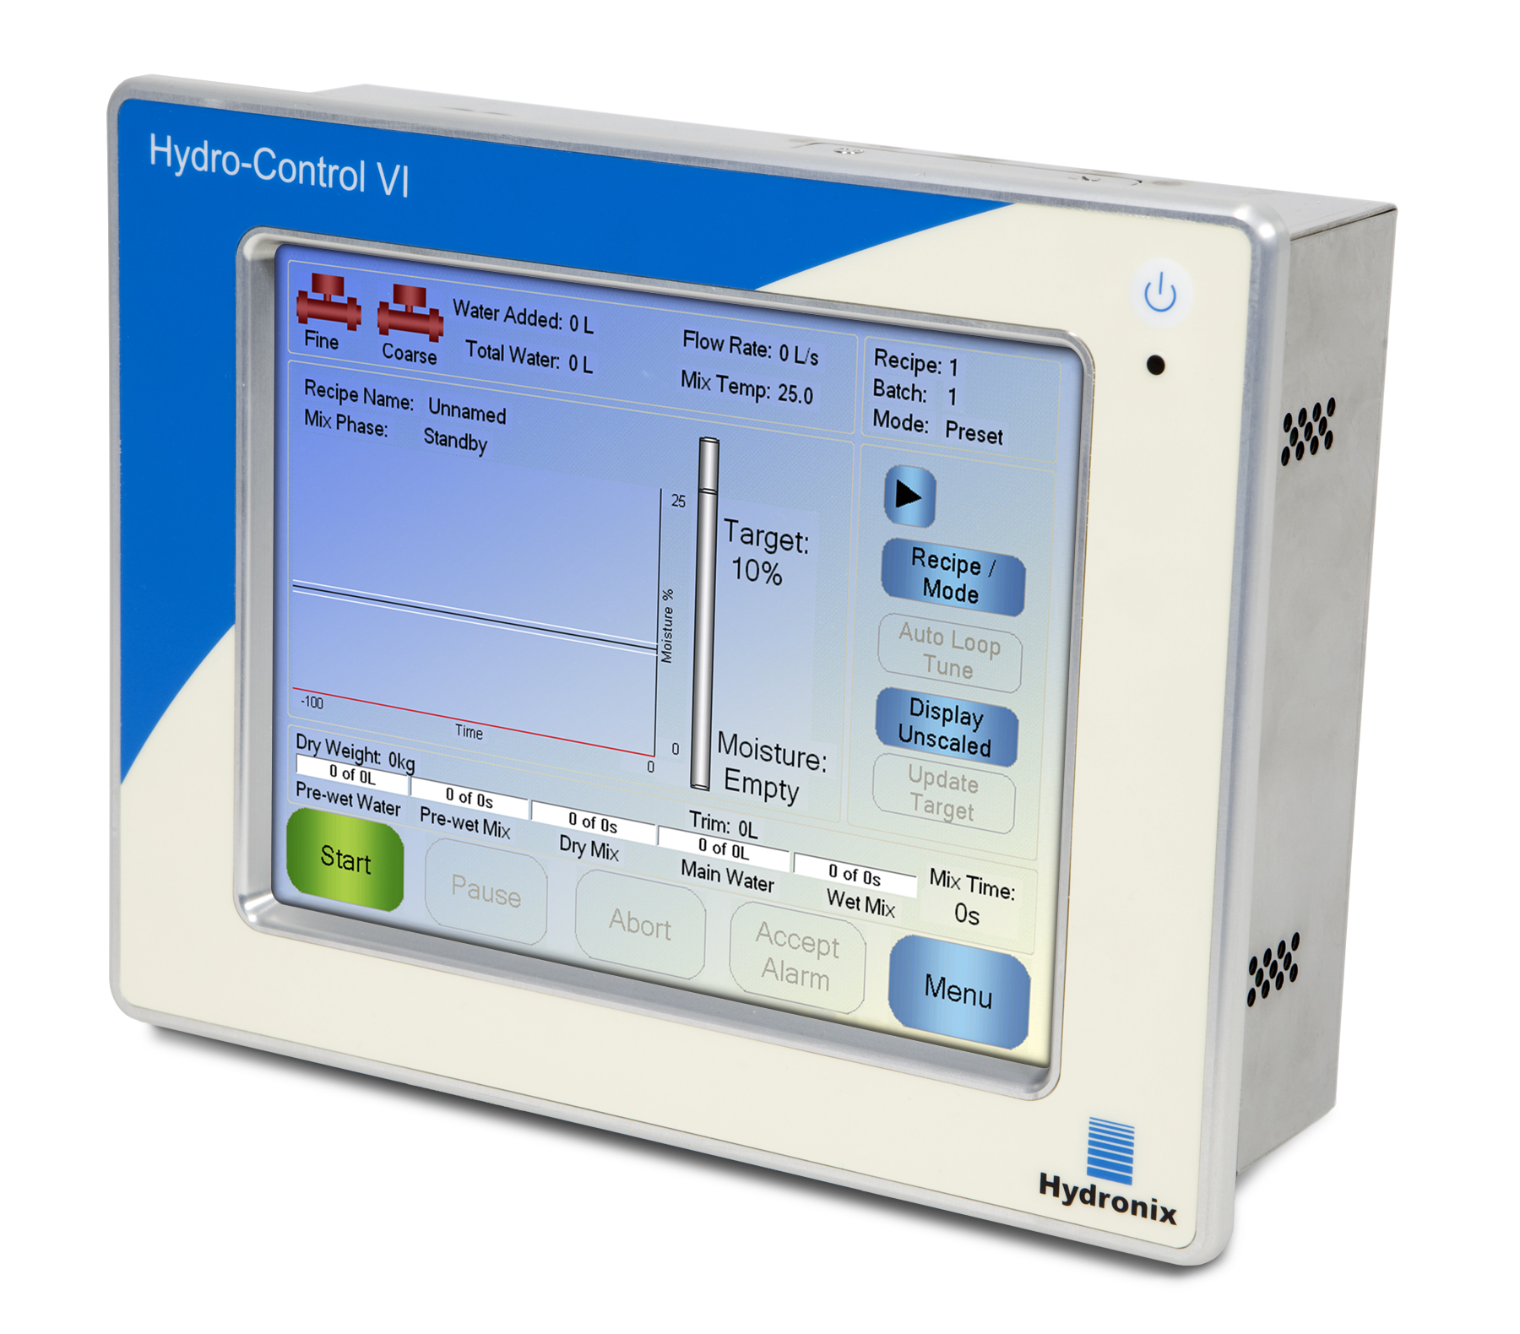
Microwave Moisture Measurement
Measurement in mixers
Hydro-Mix VII
Hydro-Probe Orbiter
Hydro-Control VI

Slide 7
Microwave Moisture Measurement
Measurement in mixers
Sensor type 1: The Hydro-Mix VII
The Hydro-Mix VII with a replaceable ceramic sensing head is mainly used in Planetary, Turbo and Horizontal mixers.
The sensor will normally be installed in the floor or in the side wall of the mixer.

Slide 8
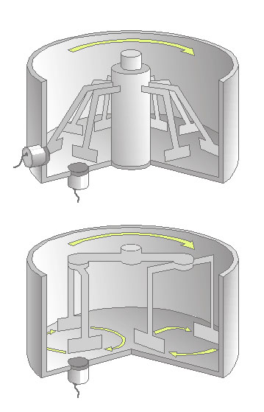
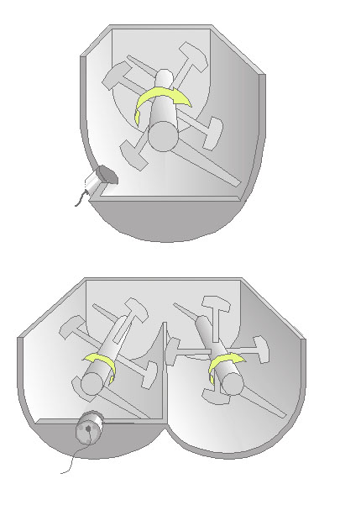
Microwave Moisture Measurement
Measurement in mixers
Installation of the Hydro-Mix VII
Single shaft mixer
Turbo mixer
Planetary mixer
Twin shaft mixer

Slide 9
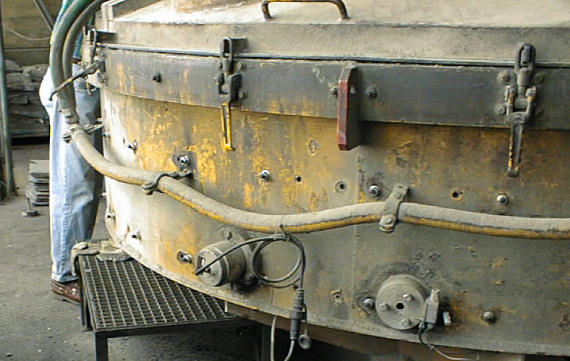
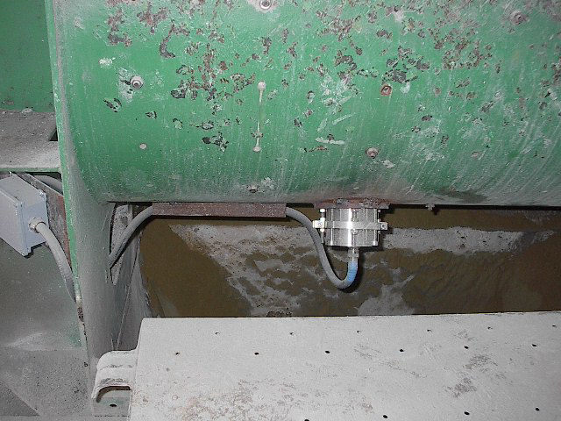
Microwave Moisture Measurement
Measurement in mixers
Installation of the Hydro-Mix VII

Slide 10
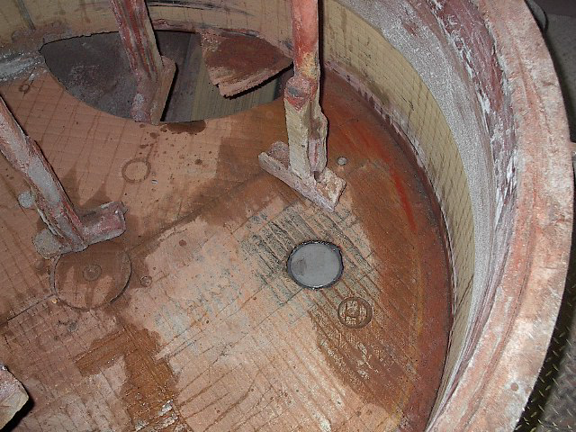
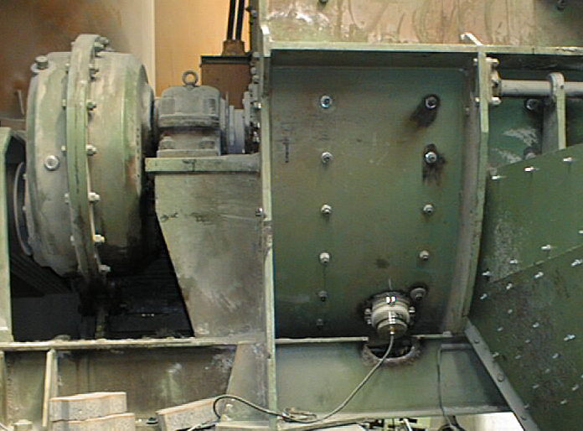
Microwave Moisture Measurement
Measurement in mixers
Installation of the Hydro-Mix VII

Slide 11
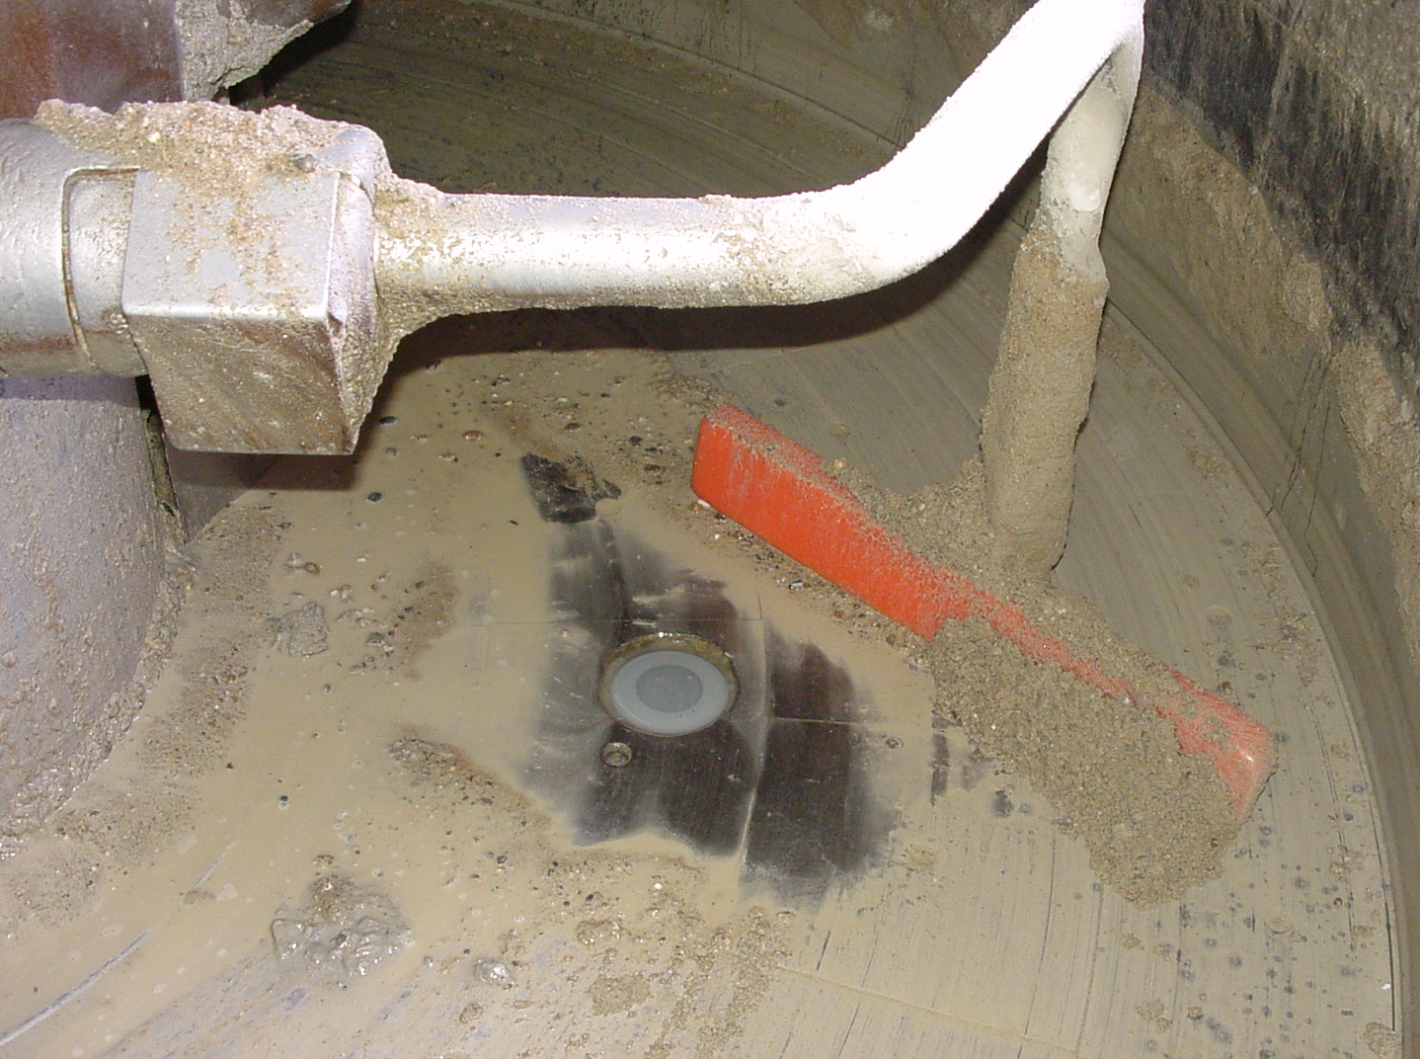
Microwave Moisture Measurement
Measurement in mixers
Installation of the Hydro-Mix VII

Slide 12
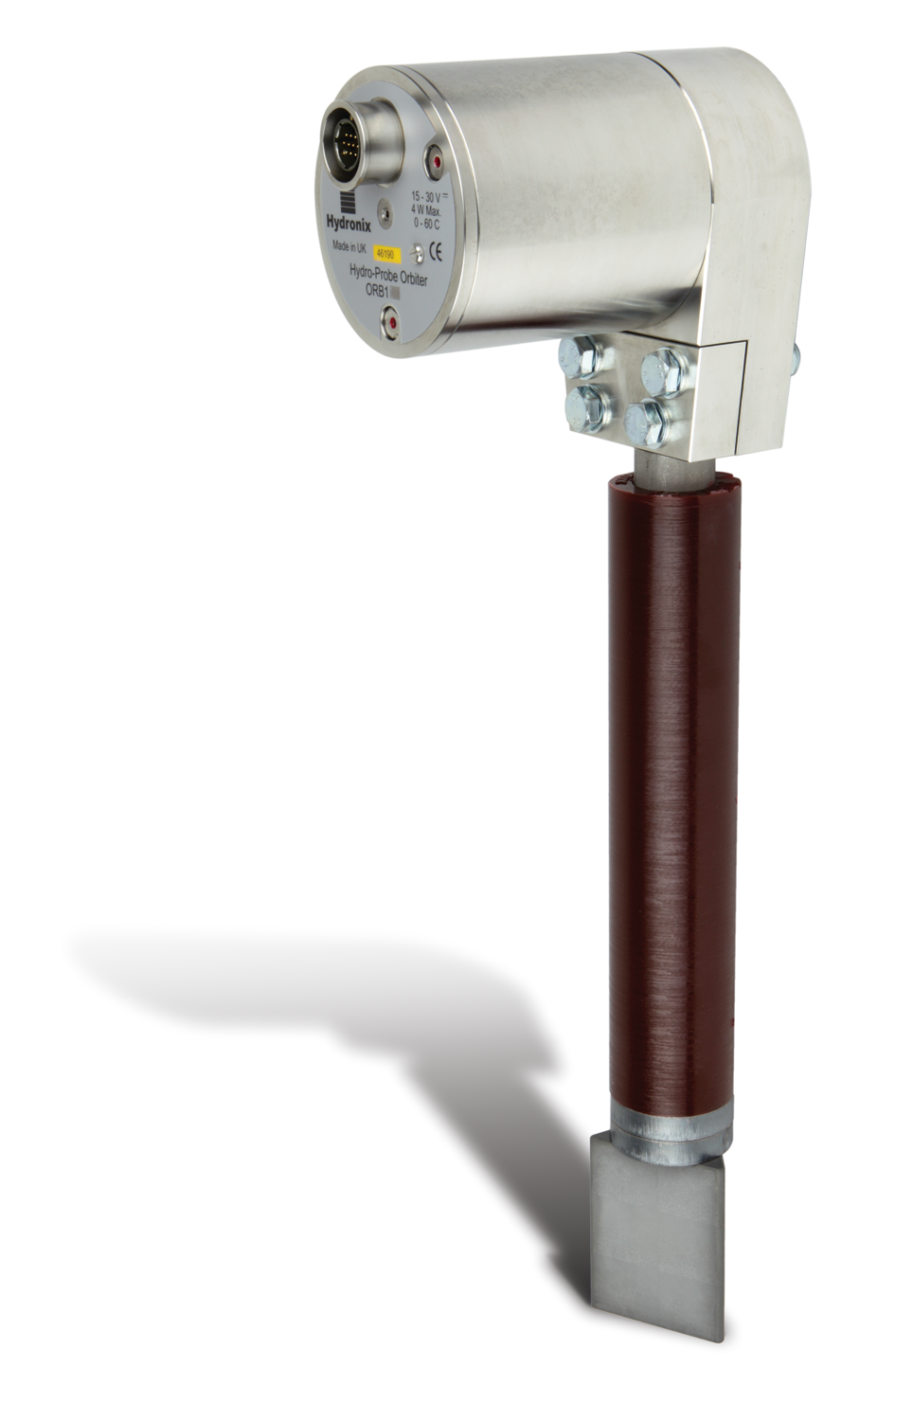
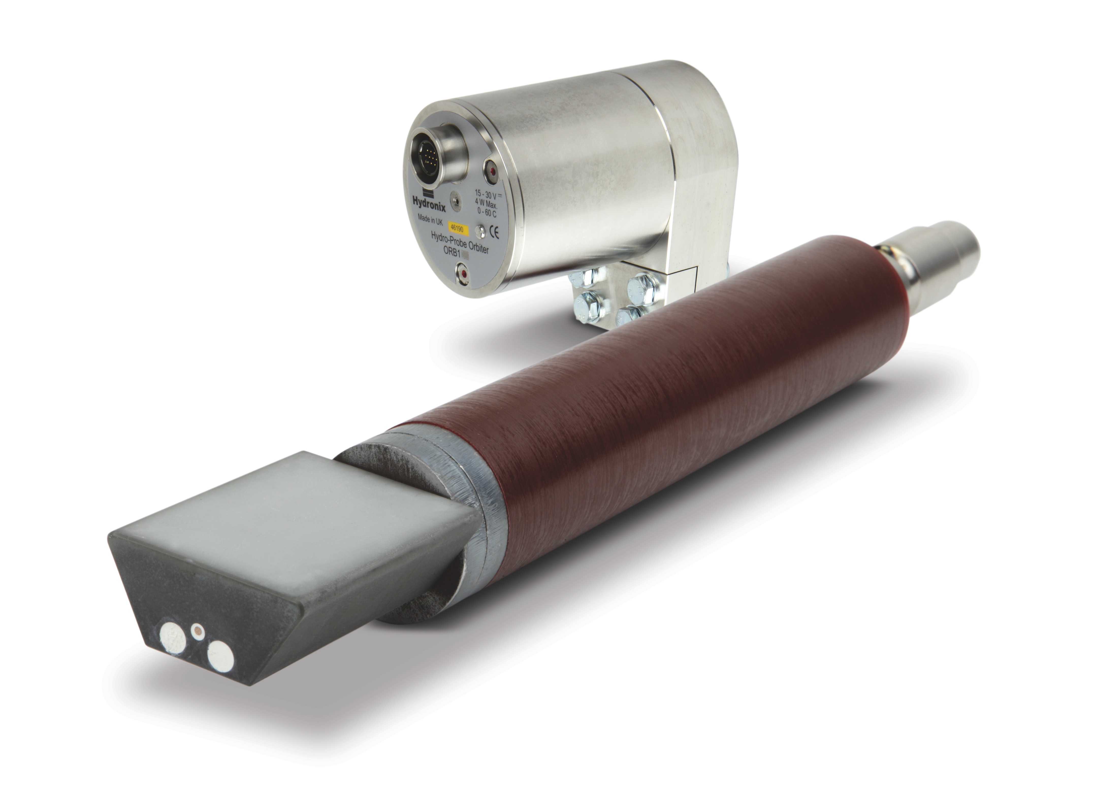
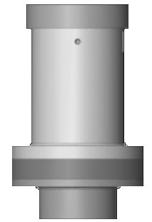
Microwave Moisture Measurement
Measurement in mixers
Sensor type 2: The Hydro-Probe Orbiter
The Hydro-Probe Orbiter with it‘s replaceable sensing arm can be used in many Turbo and Planetary mixers as a rotating sensor.
In rotating pan mixers the sensor can be installed in a static position at nearly every location in the mixer.

Slide 13
Microwave Moisture Measurement
Measurement in mixers
Sensor type 2: The Hydro-Probe Orbiter
The sensor has been designed for dynamic movement through
the material but a static installation is also possible.
Faster measurement of the complete material
Mixtime reduction possible
No impact of mixer blades and air pockets
Minimal maintenance required (the wear of the paddles and the mixer floor does not affect the measurement)
Extremely fast temperature measurement
Replaceable sensing arm

Slide 14
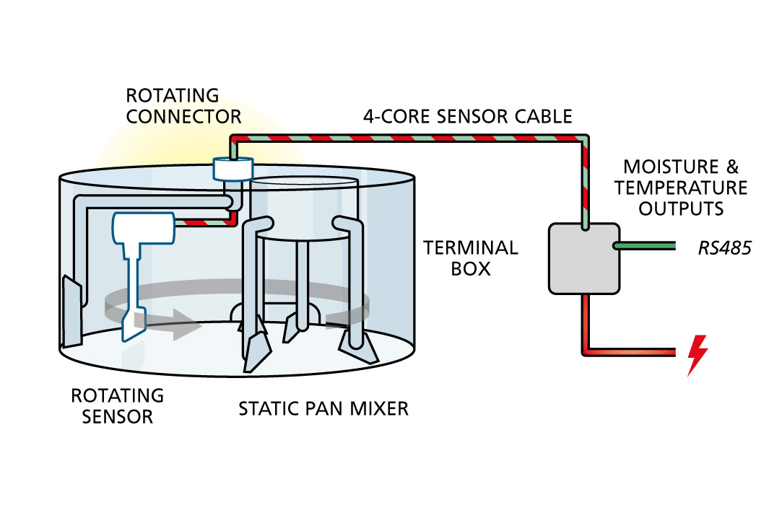
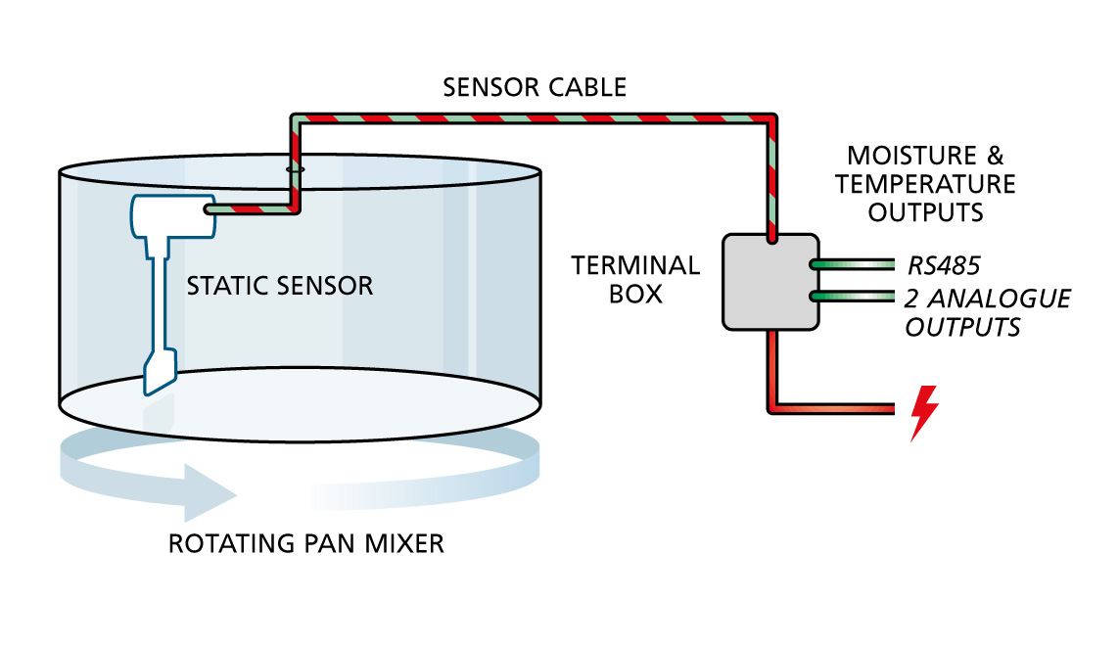
Microwave Moisture Measurement
Measurement in mixers
Installation Hydro-Probe Orbiter

Slide 15
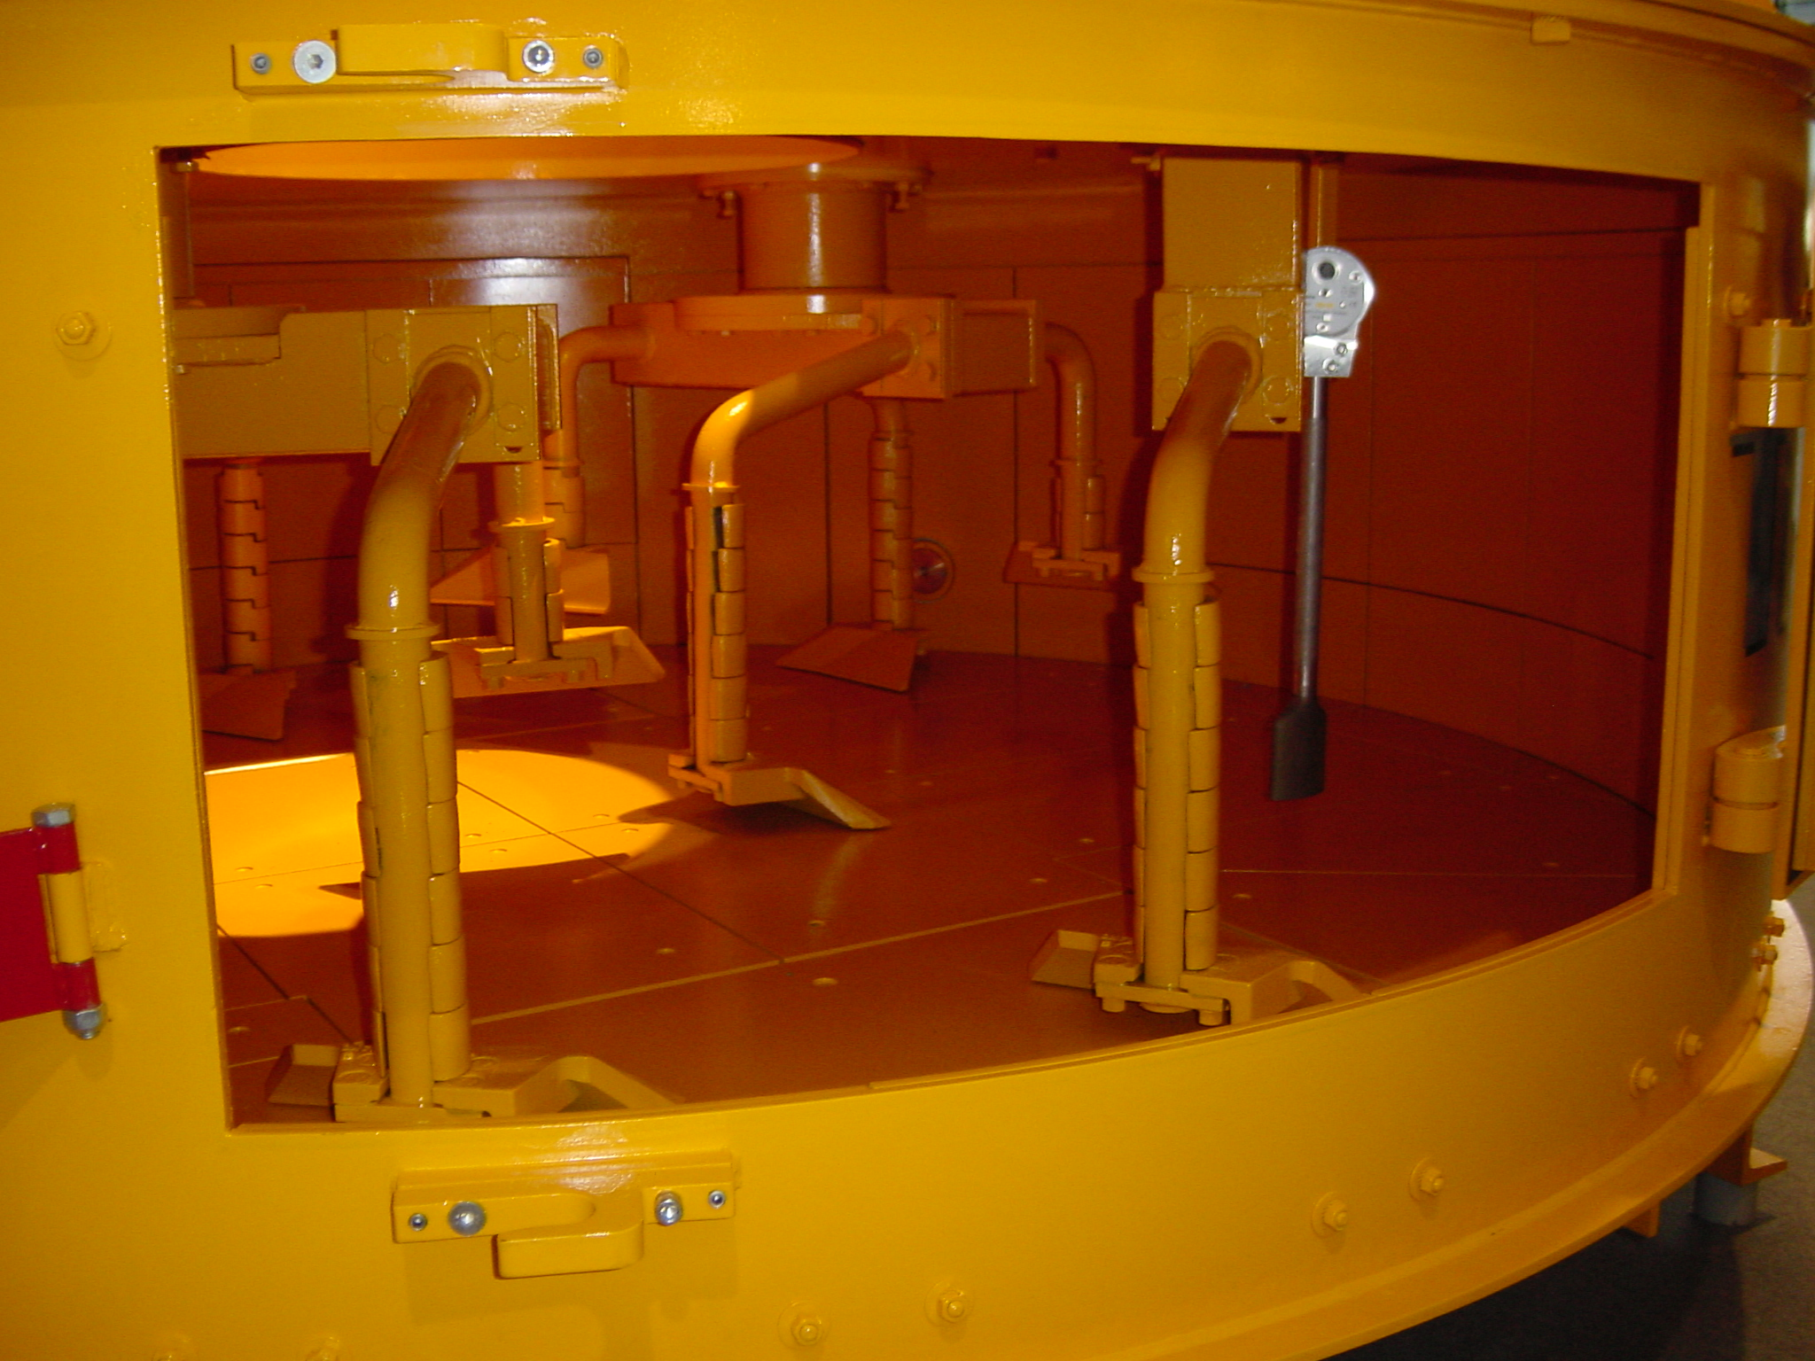
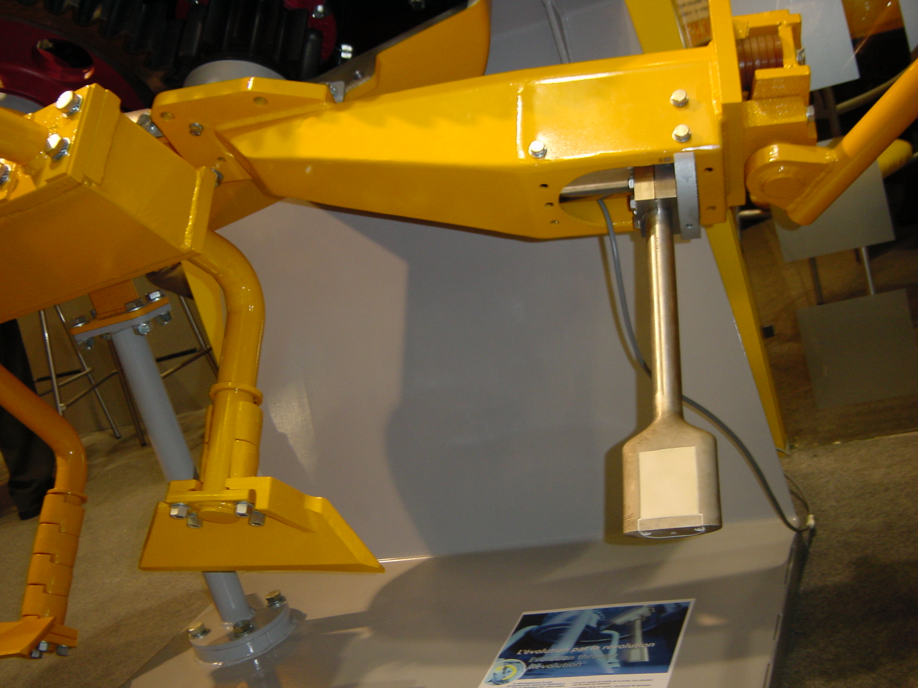
Microwave Moisture Measurement
Measurement in mixers
Installation Hydro-Probe Orbiter

Slide 16
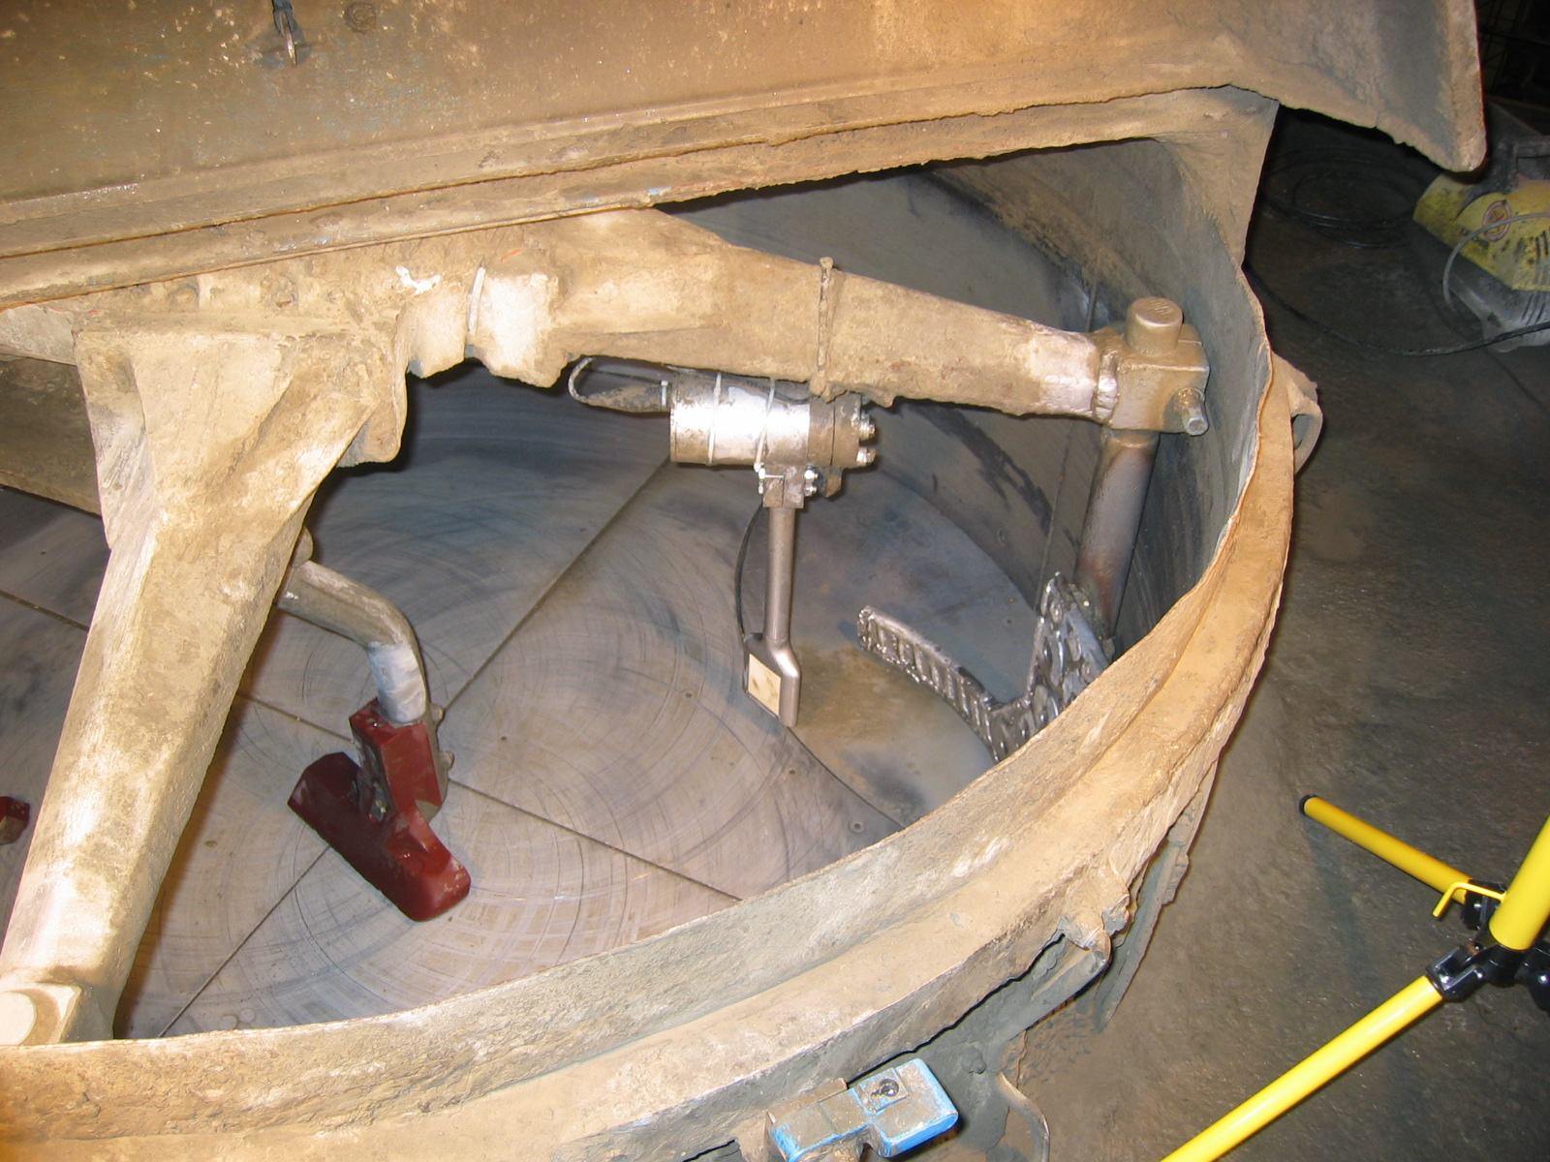
Microwave Moisture Measurement
Measurement in mixers
Installation Hydro-Probe Orbiter

Slide 17
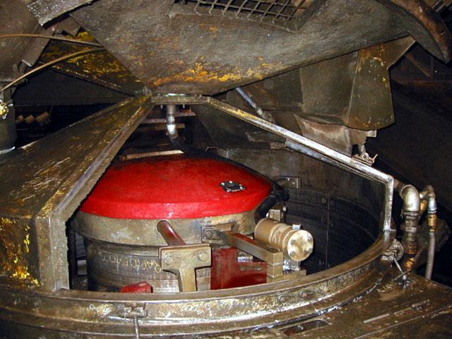
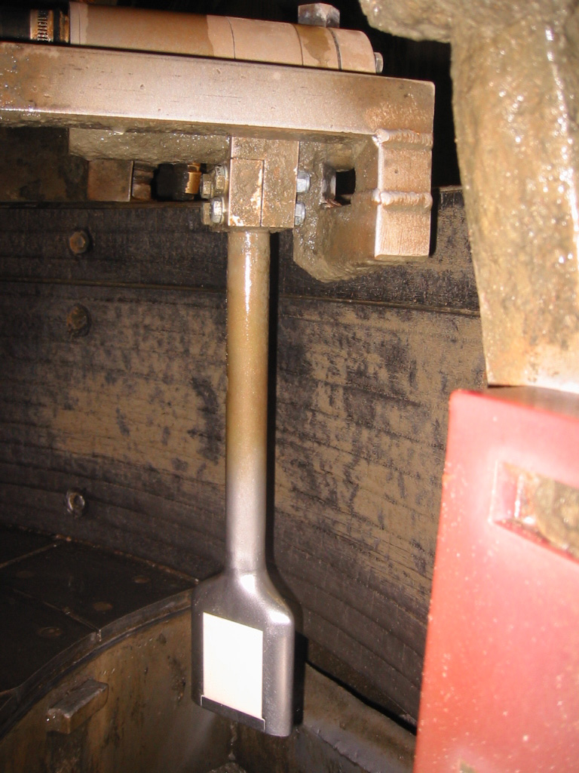
Microwave Moisture Measurement
Measurement in mixers
Installation Hydro-Probe Orbiter

Slide 18
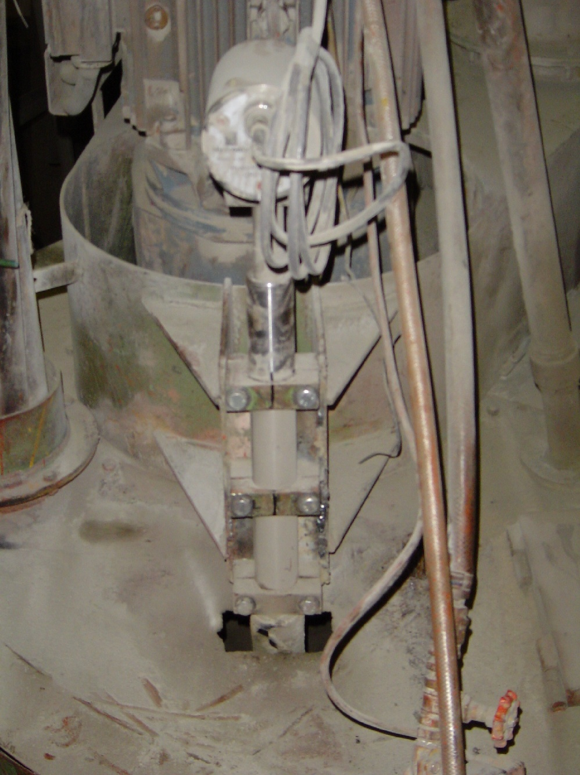
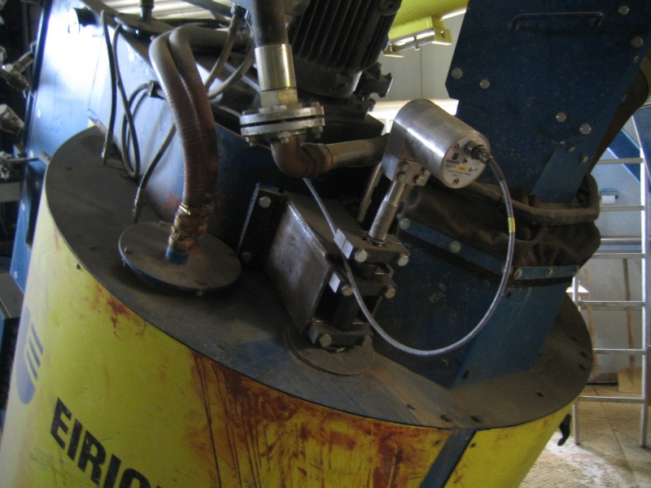
Microwave Moisture Measurement
Measurement in mixers
Installation Hydro-Probe Orbiter

Slide 19
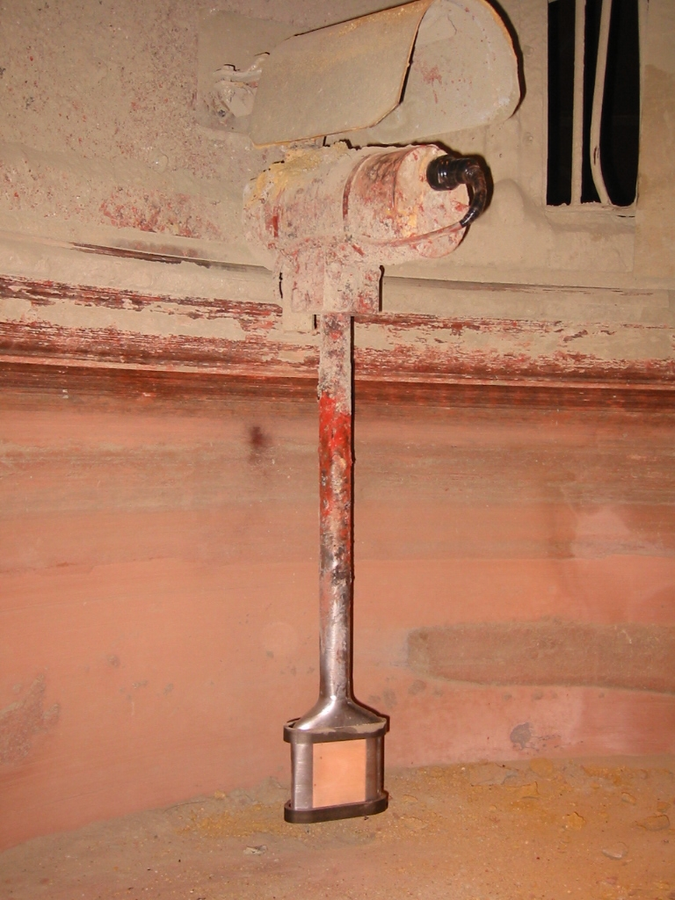
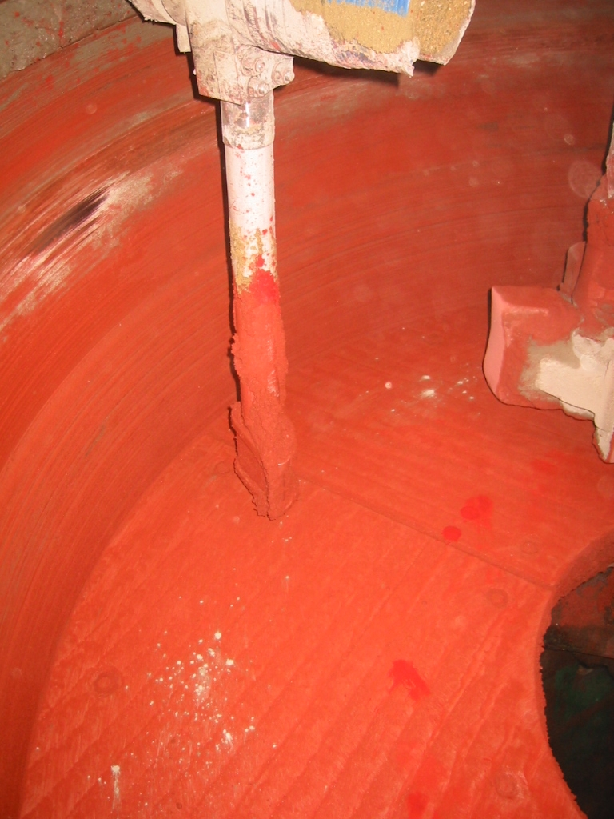
Microwave Moisture Measurement
Measurement in mixers
Installation Hydro-Probe Orbiter

Slide 20
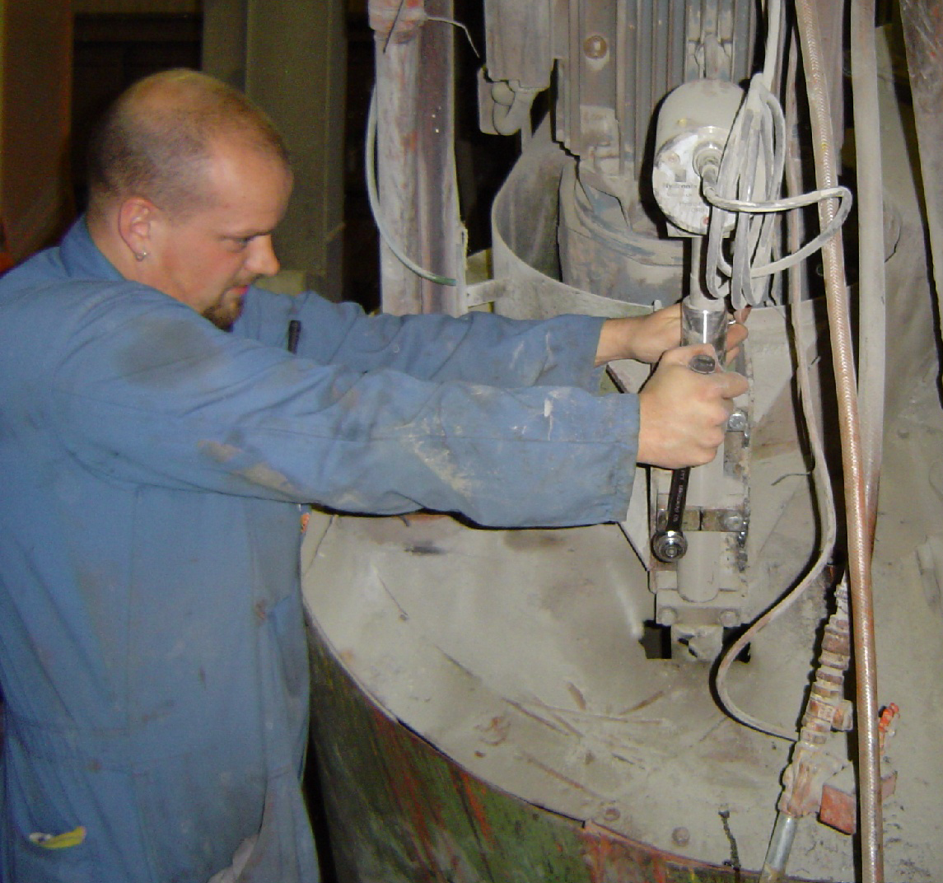
Microwave Moisture Measurement
Measurement in mixers
Installation Hydro-Probe Orbiter

Slide 21
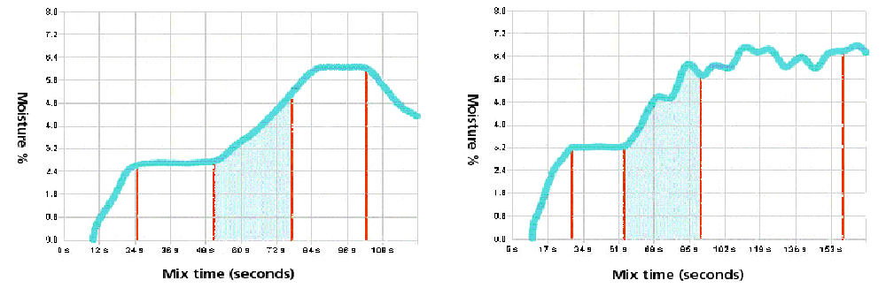
Microwave Moisture Measurement
Evaluation of mix homogeneity
How good is your mixer ?

Slide 22
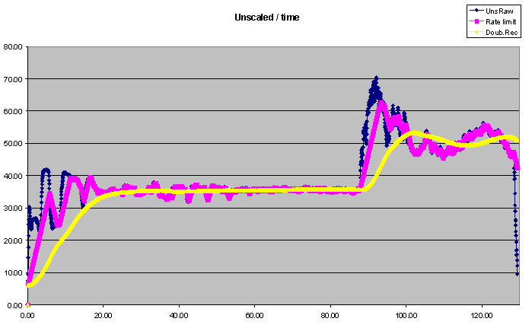
Microwave Moisture Measurement
Evaluation of mix homogeneity
Hydro-Probe Orbiter in an Eirich R-Type mixer

Slide 23
Microwave Moisture Measurement
Control of repeatability

